Slide 1
Sprint 2: Disaster Tweet Classification Using Machine Learning
Analyzing Social Media Posts for Emergency Response
by
Jonathan – Team Manager & Analyzer
Kazuki – Client Liaison & Visualizer
Jeampy – Data Modeler and Documentation
March 2025

Slide 2
Roles
Jonathan – Team Manager & Analyzer
Kazuki – Client Liaison & Visualizer
Jeampy – Data Modeler and Documentation

Slide 3
Sprints
5 Feb.
Sprint 1 – Data Collections and Database
19 Mar.
Sprint 2 – Model Building and Testing
24 Apr.
Sprint 3 - Visualizations

Slide 4
Technology and NLP Methods
Google Colab
BERT
PCA
SVM

Slide 5
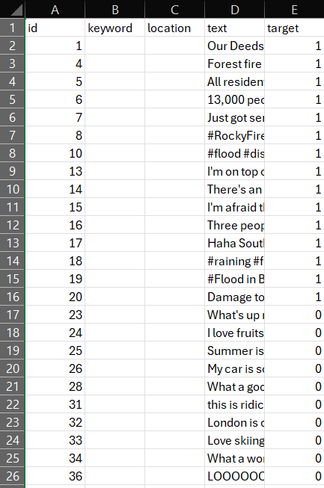
Dataset Overview
Source: train.csv (e.g., from Kaggle)
Columns:
text: Tweet content
target: 1 = Disaster, 0 = Non-disaster
Real-world disaster-related tweets dataset.

Slide 6
Problem Statement
Social media, especially Twitter, is used during disasters.
Objective: Automatically classify tweets as disaster-related or not.
Helps emergency responders filter real-time information efficiently.

Slide 7
Data Preprocessing
Converted text to lowercase
Removed URLs, digits, punctuation
Applied text cleaning function
Stored clean text in a new column 'clean_text'

Slide 8
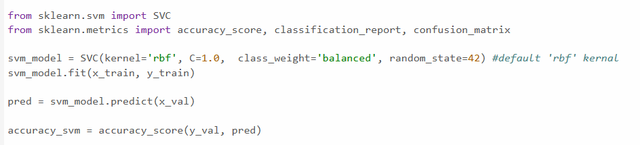
Support Vector Machine - Jon
Support Vector Machine (SVM)
Supervised learning algorithm that allows for image, text, and speech classification.
SVM in Github

Slide 9
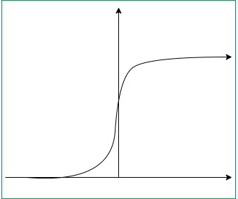
SVM Results based on Kernels
Radial Basis Function – Measures similarity between data points
Linear – Clear line to separate classes
Polynomial – Not as easy to separate classes but still follows a pattern
Sigmoid – S shape boundary. Less used and is generally used with data that has a sigmoidal pattern

Slide 10
What do the results mean?
Precision – Accuracy of predictions
Recall – Identifies true positives out of all positives
F1-score – Performance of the model
Support – Occurrence of a certain identifier
Confusion Matrix – TP – TN – FP – FN
Best Possible Model base on results?

Slide 11
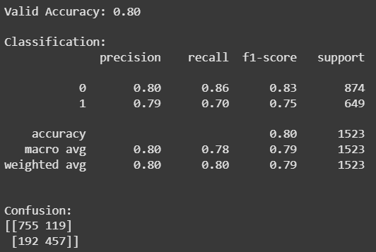
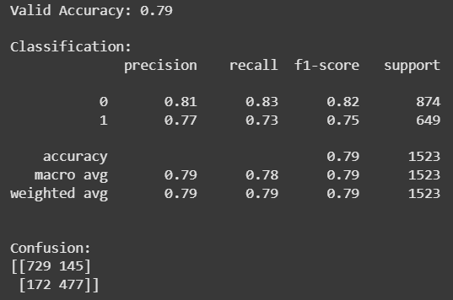
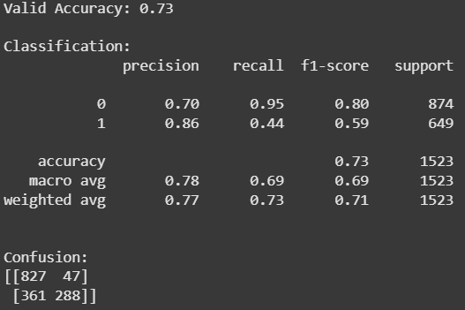
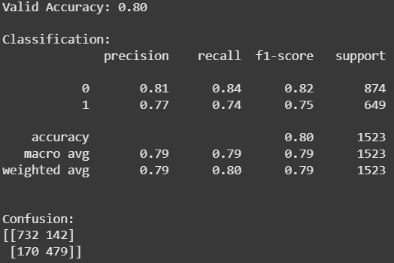
RBF vs Linear vs Poly vs Sigmoid

Slide 12
BERT Model - Kazuki
Tokenization Pipeline
Normalization
Pre-tokenization
Model (WordPiece)
Post-processing [CLS] [SEP]
Embedding
Positional Encoding
Segment Embedding
Token Embedding
BERT Notebook
BERT Notebook 2

Slide 13
Machine Learning Pipeline
TF-IDF Vectorization: Convert text to numeric features
PCA: Dimensionality reduction
Logistic Regression: Model for classification
Used scikit-learn for implementation

Slide 14
Exploratory Data Analysis
Visualized class distribution (disaster vs non-disaster)
Analyzed tweet length distribution using histogram
Used Seaborn and Matplotlib for plots

Slide 15
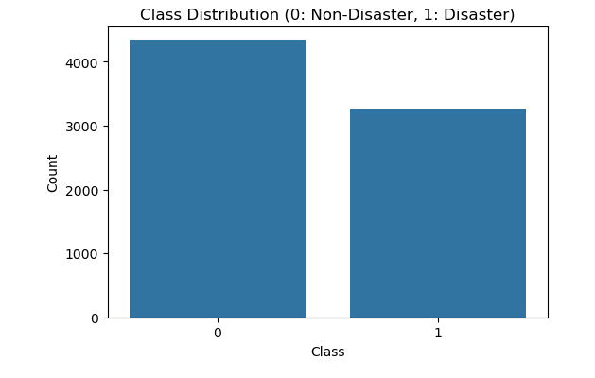

Slide 16
Word Clouds
Created separate word clouds for:
Disaster tweets
Non-disaster tweets
Visualized most frequent words

Slide 17
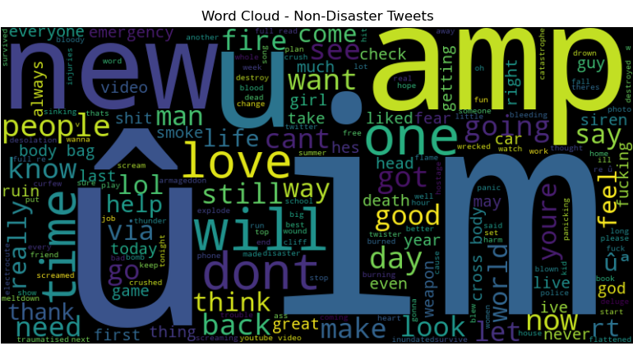

Slide 18
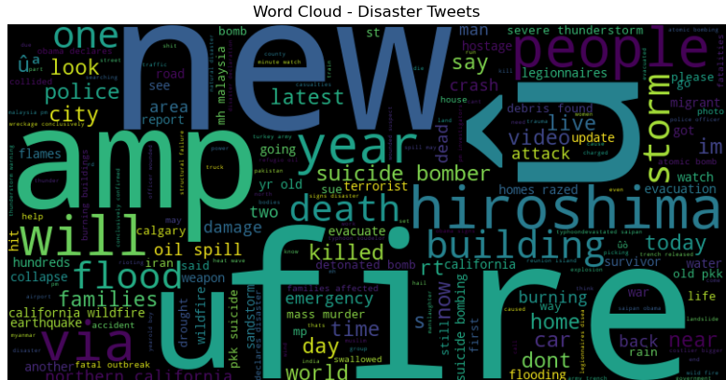

Slide 19
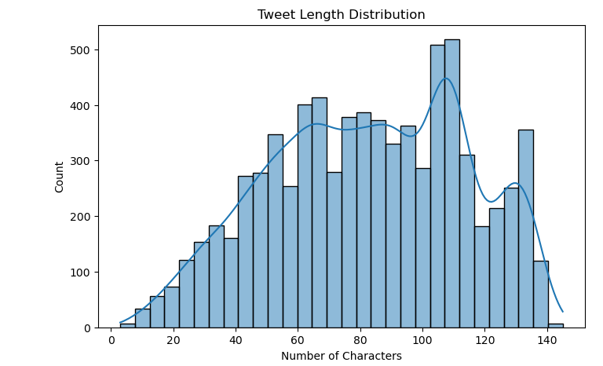
Distribution of character lengths of tweets.

Slide 20
Model Training and Testing
Split data: 80% training, 20% validation
Applied TF-IDF and PCA to both sets
Trained Logistic Regression model
Made predictions and evaluated results

Slide 21
Model Performance Evaluation
• Evaluation Metrics:
- Accuracy: Overall correctness of predictions
- F1 Score: Balance between precision and recall
• Results:
- Validation Accuracy: ~72.4%
- F1 Score: ~0.70
• Indicates good performance for imbalanced classification

Slide 22
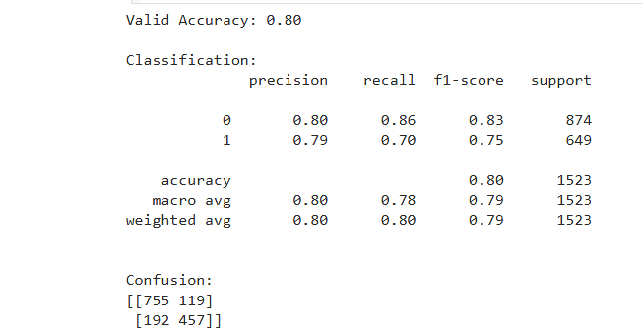
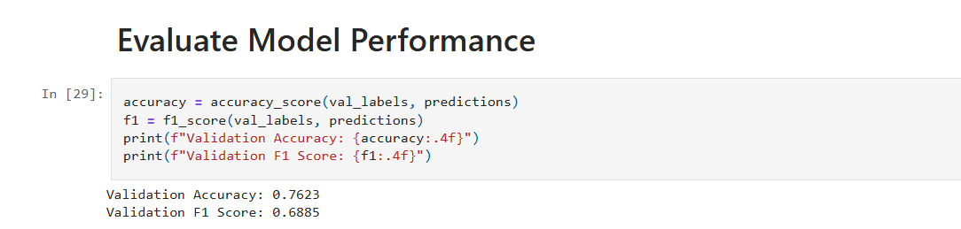
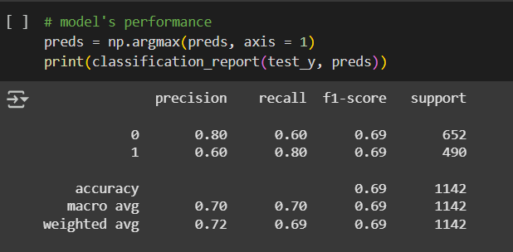
Results Between Models
SVM (RBF)
PCA
BERT

Slide 23
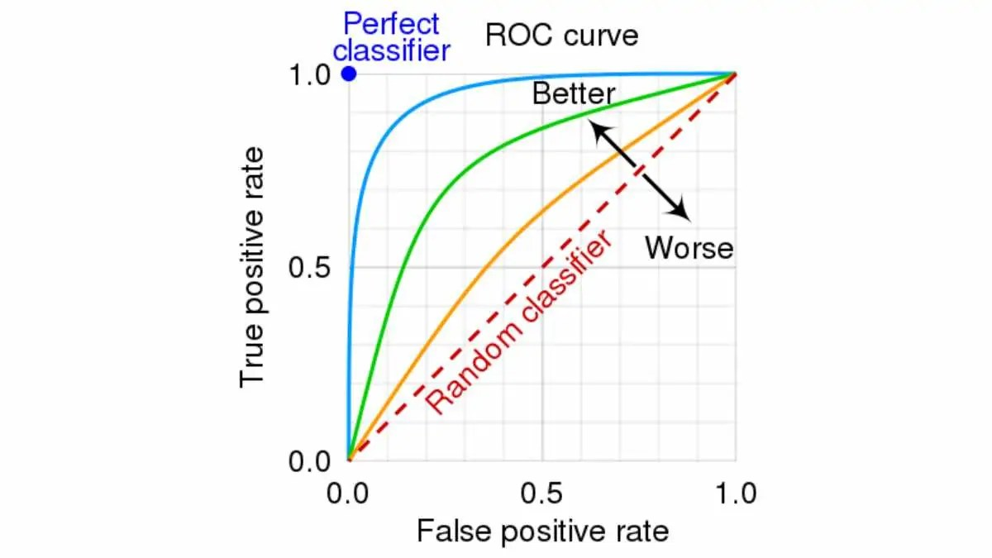
Team Plan For Iteration 3
Work on visualizations for our models (ROC Curve, Loss Curve)
Improve upon the BERT model for better results

Slide 24
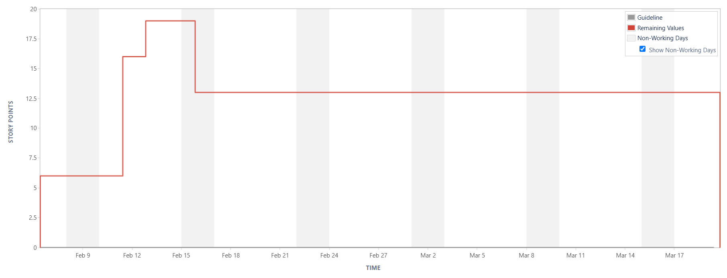
Burndown Chart

Slide 25
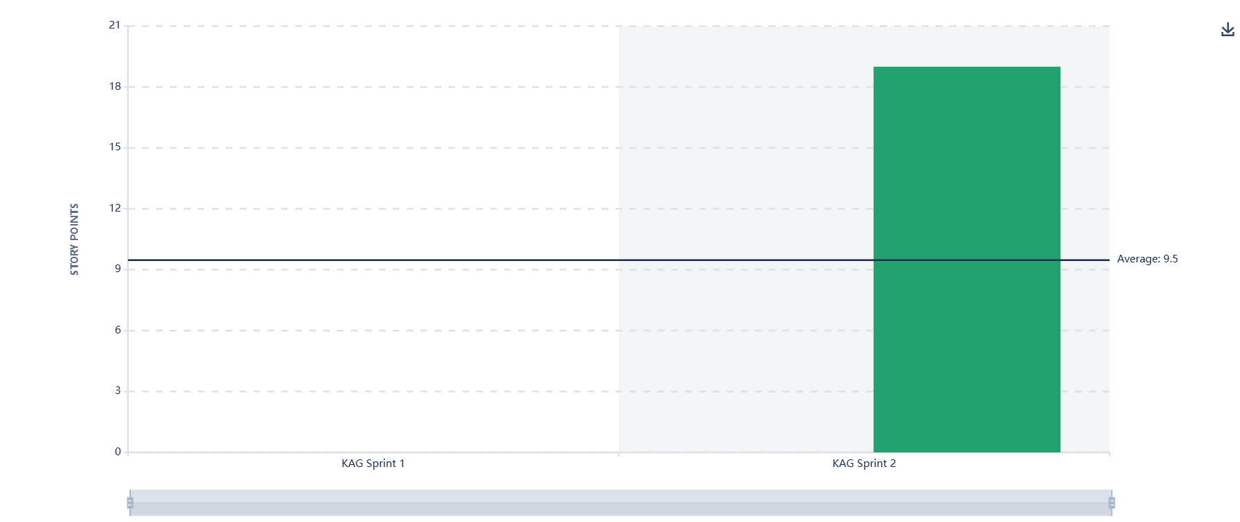
Velocity Chart

Slide 26
Q&A
Thank you for your attention!
Any questions?

